Slide 1

REST API - SharePoint
What is REST?
What is REST API?
REST API - Architectural Constraints
REST API or SOAP
REST in SharePoint
How the SharePoint 2013 REST service works
SharePoint REST API
Properties Used in Rest API
Options for Filtering and Sorting Data
Understanding SharePoint’s REST API
CAML in REST API
REST API – CRUD Operations
REST API – Send Email, Document Library, Use Properties
REST API – People Manager

Slide 2
What is REST?
REST (REpresentational State Transfer) is an architectural style, and an approach to communications that is often used in the development of Web services. The use of REST is often preferred over the more heavyweight SOAP (Simple Object Access Protocol) style because REST does not leverage as much bandwidth, which makes it a better fit for use over the Internet. The SOAP approach requires writing or using a provided server program (to serve data) and a client program (to request data).
REST'S decoupled architecture, and lighter weight communications between producer and consumer, make REST a popular building style for cloud-based APIs.

Slide 3
What is REST API?
When Web services use REST architecture, they are called RESTful APIs (Application Programming Interfaces) or REST APIs.
REST stands for Representational State Transfer. This is a term invented by Roy Fielding to describe a standard way of creating HTTP APIs. He noticed that the four common actions (view, create, edit, and delete) map directly to HTTP verbs that are already implemented: GET, POST, PUT, DELETE.
The REST API is implemented as Data-centric web service based on the Open Data Protocol or OData. The way these web services work, use each resource in the system is addressable by a specific URL that you pass off to the server.

Slide 4
REST API - Architectural Constraints
The REST architectural style describes six constraints. These constraints, applied to the architecture, were originally communicated by Roy Fielding in his doctoral dissertation and defines the basis of RESTful-style.
Uniform Interface
Stateless
Cacheable
Client-Server
Layered System
Code on Demand (optional)

Slide 5
REST API or SOAP
RESTful Web services are easy to leverage by most tools, including those that are free and inexpensive.
SOAP services are much harder to scale than RESTful services. Thus, REST is often chosen as the architecture for services that are exposed via the Internet
The learning curve seems to be reduced.
REST uses a smaller message format than SOAP. SOAP uses XML for all messages, which makes the message size much larger, and thus less efficient. This means REST provides better performance, as well as lowers costs over time.
It is much faster than traditional SOAP.
REST is designed for use over the Open Internet/Web and hence is a better choice for cloud-based platforms.
There is no direct support for generating a client from server-side-generated metadata. SOAP is able to support this with Web Service Description Language (WSDL).

Slide 6
REST in SharePoint
SharePoint 2013 introduces a Representational State Transfer (REST) service that is comparable to the existing SharePoint client object models. Now, developers can interact remotely with SharePoint data by using any technology that supports REST web requests. This means that developers can perform Create, Read, Update, and Delete (CRUD) operations from their SharePoint Add-ins, solutions, and client applications, using REST web technologies and standard Open Data Protocol (OData) syntax.
The REST API is implemented as Data-centric web service based on the Open Data Protocol or OData. The way these web services work, use each resource in the system is addressable by a specific URL that you pass off to the server.

Slide 7
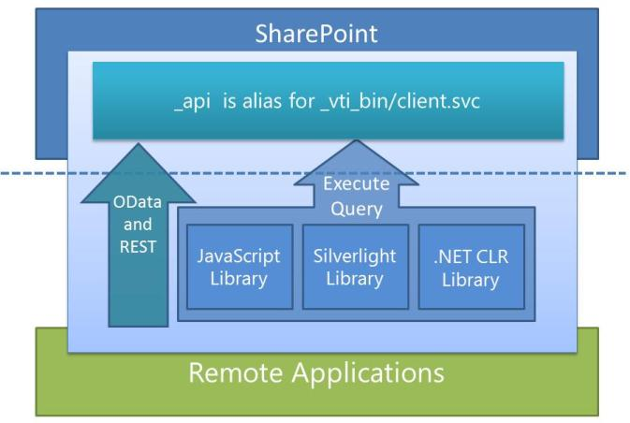
REST in SharePoint
All we’re doing is replacing the url
If you’re still on SP 2010 the querystring section of the examples below may be the same. The only difference is the endpoint part of the url. SP 2010 has below:
Selecting all items, all columns
The simplest way to grab list items is to get everything. This is done by using the endpoint below. Simply change the “list” value to your own:
1 | _spPageContextInfo.webAbsoluteUrl + "/_vti_bin/listdata.svc/" + querystring
1 | _spPageContextInfo.webAbsoluteUrl + "/_api" + /web/lists/getbytitle('listname')/Items?$select=*";

Slide 8
How the SharePoint 2013 REST service works
SharePoint 2013 adds the ability for you to remotely interact with SharePoint sites by using REST. Now, you can interact directly with SharePoint objects by using any technology that supports standard REST capabilities.
To access SharePoint resources using REST, construct a RESTful HTTP request, using the Open Data Protocol (OData) standard, which corresponds to the desired client object model API. For example: Client object model method:
List.GetByTitle(listname)
REST endpoint:
http://server/site/_api/lists/getbytitle('listname')

Slide 9
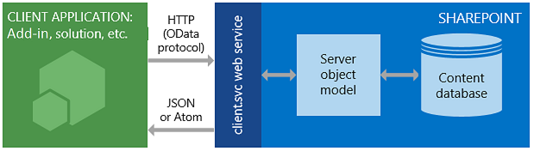
How the SharePoint 2013 REST service works
The client.svc web service in SharePoint handles the HTTP request, and serves the appropriate response in either Atom or JSON (JavaScript Object Notation) format. Your client application must then parse that response. The figure below shows a high-level view of the SharePoint REST architecture.
SharePoint REST service architecture
Because of the functionality and ease of use that client object models provide, they remain the primary development option for communicating with SharePoint sites by using .NET Framework managed code, Silverlight, or JavaScript.

Slide 10
SharePoint REST API
SharePoint 2013 has a REST API that exposes plenty of information about users, lists and document libraries.
It is important to recognize that SharePoint is using OData, which is a widely used convention when in comes to RESTful web services.
Simple REST API call will look like below
2 3 4 5 6 7 8 | $.ajax({ url: url, //THE ENDPOINT method: "GET", headers: { "Accept": "application/json; odata=verbose" }, success: function (data) { console.log(data.d.results) //RESULTS HERE!! } });

Slide 11
Properties Used in Rest API
Properties | When required | Description
url | All requests | The URL of the REST resource endpoint. Example: http://<site url>/_api/web/lists
method (or type) | All requests | The HTTP request method: GET for read operations and POST for write operations. POST requests can perform update or delete operations by specifying a DELETE, MERGE, or PUT verb in the X-HTTP-Method header.
body (or data) | POST requests that send data in the request body | The body of the POST request. Sends data (such as complex types) that can't be sent in the endpoint URI. Used with the content-length header.
Authentication header | Remote add-ins that are using OAuth to authenticate users. Does not apply when using JavaScript or the cross domain library. | Sends the OAuth access token (obtained from a Microsoft Access Control Service (ACS) secure token server) that's used to authenticate the user for the request. Example: "Authorization": "Bearer " + accessToken, where accessToken represents the variable that stores the token. Tokens must be retrieved by using server-side code.

Slide 12
Properties Used in Rest API
Properties | When required | Description
X-RequestDigest header | POST requests (except SP.RequestExecutor requests) | Remote add-ins that use OAuth can get the form digest value from the http://<site url>/_api/contextinfo endpoint. SharePoint-hosted add-ins can get the value from the #__REQUESTDIGEST page control if it's available on the SharePoint page.
accept header | Requests that return SharePoint metadata | Specifies the format for response data from the server. The default format is application/atom+xml. Example: "accept":"application/json;odata=verbose"
content-type header | POST requests that send data in the request body | Specifies the format of the data that the client is sending to the server. The default format is application/atom+xml. Example: "content-type":"application/json;odata=verbose"
content-length header | POST requests that send data in the request body (except SP.RequestExecutor requests) | Specifies the length of the content. Example: "content-length":requestBody.length

Slide 13
Properties Used in Rest API
Properties | When required | Description
IF-MATCH header | POST requests for DELETE, MERGE, or PUT operations, primarily for changing lists and libraries. | Provides a way to verify that the object being changed has not been changed since it was last retrieved. Or, lets you specify to overwrite any changes, as shown in the following example: "IF-MATCH":"*"
X-HTTP-Method header | POST requests for DELETE, MERGE, or PUT operations | Used to specify that the request performs an update or delete operation. Example: "X-HTTP-Method":"PUT"
binaryStringRequestBody | SP.RequestExecutor POST requests that send binary data in the body | Specifies whether the request body is a binary string. Boolean.
binaryStringResponseBody | SP.RequestExecutor requests that return binary data | Specifies whether the response is a binary string. Boolean.

Slide 14
Options for Filtering and Sorting Data
Option | Purpose | Example
$select | Specifies which fields are included in the returned data. | _api/web/lists/getByTitle('Books')/items?$select=Author,Title,ISBN
$filter | Specifies which members of a collection, such as the items in a list, are returned. | _api/web/lists/getByTitle('Books')/items?$filter=Author eq 'Mark Twain'
$expand | Specifies which projected fields from a joined list are returned. | _api/web/lists/getByTitle( 'Books')/items?$select=Title,PublishedBy/Name&$expand=PublishedBy
$top | Returns only the first n items of a collection or list. | _api/web/lists/getByTitle('Books')/items?$top=10
$skip | Skips the first n items of a collection or list and returns the rest. | _api/web/lists/getByTitle('Books')/items?$top=10&$skip=2
$orderby | Specifies the field that’s used to sort the data before it’s returned. | _api/web/lists/getByTitle('Books')/items?$orderby=Title asc

Slide 15
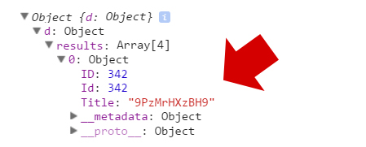
Understanding SharePoint’s REST API
Selecting all items, custom columns
Good practice to only grab the columns that you need. This makes the payload as lean as possible.:
1 | _spPageContextInfo.webAbsoluteUrl + "/_api" + “/web/lists/getbytitle('listname')/Items?$select=ID,Title";

Slide 16
Understanding SharePoint’s REST API
Getting the total items in a list
Retrieving specific list items
Getting the Author Information
1 | _spPageContextInfo.webAbsoluteUrl + "/_api/web/lists/getbytitle('listName')/ItemCount
1 | _spPageContextInfo.webAbsoluteUrl + "/_api/web/lists/getbytitle('listname')/items(4)
1 | _spPageContextInfo.webAbsoluteUrl + “/_api/web/lists/getbytitle('listname')/Items?$select=Author/Title,Comment&amp;$expand=Author

Slide 17
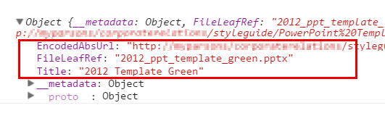
Understanding SharePoint’s REST API
Document Libraries Querying lists that are document libraries can also be handled in similar way as like we do for normal lists
1 | _spPageContextInfo.webAbsoluteUrl + "/_api/web/lists/getbytitle('Document Library Name')/Items?$select=Title, FileLeafRef, EncodedAbsThumbnailUrl, EncodedAbsUrl

Slide 18
Understanding SharePoint’s REST API
Document Libraries To know the “type” of document library
some information regarding document libraries require an entirely new endpoint. This includes file paths, subfolders, thumbnails and such.
1 | _spPageContextInfo.webAbsoluteUrl + "/_api/web/lists/getbytitle('Document Library Name')/BaseTemplate
1 | _spPageContextInfo.webAbsoluteUrl + "/_api/web/GetFolderByServerRelativeUrl('"Folder Name"')/Files"

Slide 19
CAML in REST API
Situations forced to use CSOM
Inability to filter items based on multivalued
taxonomy fields
Inability to filter items based on user fields
where user is added through a group,
rather than directly, e.g. AssignedTo=[Me]
combined with a SharePoint group.
Example :
function getDataWithCaml(listName, caml) { var endpoint = "/_api/web/lists/GetByTitle('" + listName + "')/GetItems"; var requestData = { "query" : {"__metadata": { "type": "SP.CamlQuery" } , "ViewXml": caml } }; return jQuery.ajax({ url: endpoint, method: "POST", data: requestData, headers: { "X-RequestDigest": $("#__REQUESTDIGEST").val(), "Accept": "application/json; odata=verbose", "Content-Type": "application/json; odata=verbose" } }); }
var caml = "<View><Query><Where><Or><Eq><FieldRef Name='AssignedTo' /><Value Type='Integer'><UserID/></Value></Eq><Membership Type='CurrentUserGroups'><FieldRef Name='AssignedTo' /> </Membership></Or></Where></Query></View>";
getDataWithCaml("Tasks", caml);

Slide 20
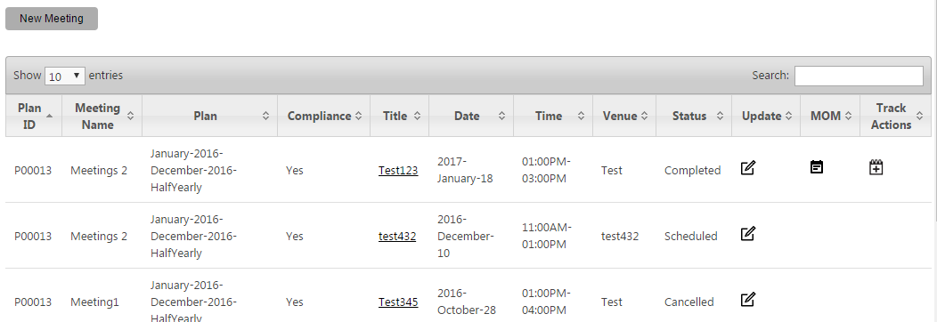
REST API – CRUID Operations
Get list item
function getListItemWithId(itemId, listName, siteurl, success, failure) { var url = _spPageContextInfo.siteAbsoluteUrl + "/_api/web/lists/getbytitle('" + listName + "')/items?$filter=Id eq " + itemId; $.ajax({ url: url, method: "GET", headers: { "Accept": "application/json; odata=verbose" }, success: function (data) { if (data.d.results.length == 1) { success(data.d.results[0]); } else {failure("Multiple results obtained for the specified Id value"); } }, error: function (data) {failure(data);} }); }
Sample Screenshot

Slide 21
REST API – CRUID Operations
Create list item
var listname = "ListName"; var itemType = "SP.Data." + listname.charAt(0).toUpperCase() + listname.split(" ").join("").slice(1) + "ListItem"; var item = { "__metadata": { "type": itemType }, "Title": "Hello", }; $.ajax({ url: _spPageContextInfo.siteAbsoluteUrl + "/_api/web/lists/getbytitle('" + listname + "')/items", type: "POST", async : false, contentType: "application/json;odata=verbose", data: JSON.stringify(item), headers: { "Accept": "application/json;odata=verbose", "X-RequestDigest": $("#__REQUESTDIGEST").val() }, success: function (data) {}, error: function (data) {} });

Slide 22
REST API – CRUID Operations
Update list item
var itemProperties = {'Title':"Hello Updated",'OtherFiled':"Updated Value"}; var listItemUri = _spPageContextInfo.siteAbsoluteUrl + "/_api/web/lists/getbytitle('ListName')/items(" + curtransid + ")"; var itemPayload = { '__metadata': {'type': getItemTypeForListName('ModuleTransactions')} }; for(var prop in itemProperties){ itemPayload[prop] = itemProperties[prop]; } $.ajax({ url: listItemUri, type: "POST", async : false, data: JSON.stringify(itemPayload), contentType: "application/json;odata=verbose", headers: { "Accept": "application/json;odata=verbose", "X-RequestDigest" : $("#__REQUESTDIGEST").val(), "X-HTTP-Method": "MERGE", "If-Match": "*" }, success: function (data) { alert(' List Item Updated');}, error: function (data) {alert("Error occurred");} });

Slide 23
REST API – CRUID Operations
Delete list item
function deleteListItem(itemId, listName, siteUrl, success, failure) { getListItemWithId(itemId, listName, siteUrl, function (data) { $.ajax({ url: data.__metadata.uri, type: "POST", headers: { "Accept": "application/json;odata=verbose", "X-Http-Method": "DELETE", "X-RequestDigest": $("#__REQUESTDIGEST").val(), "If-Match": data.__metadata.etag }, success: function (data) {success(data);}, error: function (data) {failure(data);} }); }, function (data) {failure(data);}); }
The SharePoint REST service, which follows the OData standard, uses HTML ETags for concurrency control of SharePoint lists and list items.
To check on an item’s version when you perform a PUT, MERGE, or DELETE request, specify an ETag in the If-Match HTTP request header.
If the ETag you specify in your request does not match the ETag of the document or list item on the server, the REST service returns a 412 exception, per the OData specification.
To force an overwrite of the item regardless of version, set the ETag value to "*".
If you do not specify an ETag, SharePoint overwrites the item regardless of version.

Slide 24
REST API – CRUID Operations
Get item type for list name example: SP.Data.TestListItem
var itemType = {typeName:null}; function getItemTypeListName(listTitle) { $.ajax({ async: false, url: _spPageContextInfo.siteAbsoluteUrl + "/_api/web/lists/getbytitle('" + listTitle + "')/?$select=ListItemEntityTypeFullName", method: "GET", headers: { "Accept": "application/json; odata=verbose" }, success: function(data) { if(data.d.ListItemEntityTypeFullName){ itemType. typeName = data.d.ListItemEntityTypeFullName; } }, error: function(data) { itemType. typeName = ""; } }); }

Slide 25
REST API – Send Email
var urlTemplate = _spPageContextInfo.siteAbsoluteUrl + "/_api/SP.Utilities.Utility.SendEmail"; var emailTo = "temp@email.com"; // Should be valid email ID under your domain $.ajax({ contentType: 'application/json', url: urlTemplate, type: "POST", data: JSON.stringify({ 'properties': { '__metadata': { 'type': 'SP.Utilities.EmailProperties' }, 'From': "frommail", 'To': { 'results': [emailTo] }, 'Body': mailbody, 'Subject': subjectline } }), headers: { "Accept": "application/json;odata=verbose", "content-type": "application/json;odata=verbose", "X-RequestDigest": $("#__REQUESTDIGEST").val() }, success: function (data) {alert("Mail sent");}, error: function (err) {alert("error occured");} });

Slide 26
REST API – Show files from document library
_spPageContextInfo.siteAbsoluteUrl + '/_api/web/lists/getbytitle('Attachments')/Items?$select=EncodedAbsUrl,Created,FileLeafRef,*&$filter=ID%20eq%20" + Itemid, Or if list item attachment _spPageContextInfo.siteAbsoluteUrl + "/_api/web/lists/getbytitle('"+querylistname+"')/items(" + resitemid + ")/AttachmentFiles“ Call: /Lists/listname/Attachments/itemid/"+data.d.results[i].FileName
REST API – Get user properties (Siteuserinfo list)
url: _spPageContextInfo.siteAbsoluteUrl + '/_api/Web/GetUserById('+id+')‘ Or if no id is present url: _spPageContextInfo.siteAbsoluteUrl + "/_api/web/siteusers(@v)?@v='" + encodeURIComponent(accountName) + "'",

Slide 27
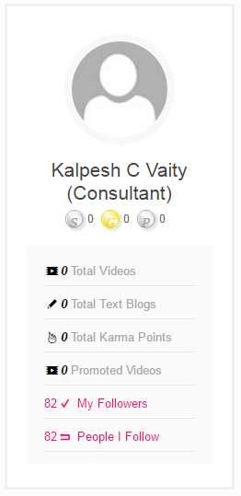
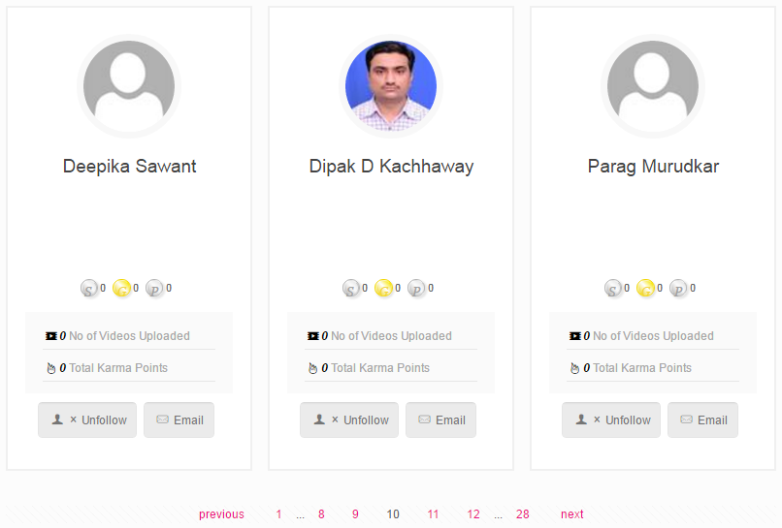
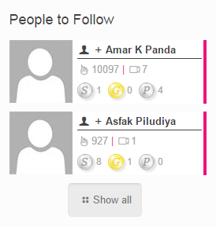
REST API – People Manager
Functionality | Method | Url
Get My Followers | GET | /_api/SP.UserProfiles.PeopleManager/getmyfollowers
Am I following | GET | /_api/SP.UserProfiles.PeopleManager/amifollowing(@v)?@v='" + targetUser + "'
Follow | POST | /_api/SP.UserProfiles.PeopleManager/follow(@v)?@v='" + targetUser + "'
Un follow | POST | /_api/SP.UserProfiles.PeopleManager/stopfollowing(@v)?@v='" + targetUser + "'
Get people followed by me | GET | /_api/SP.UserProfiles.PeopleManager/getpeoplefollowedbyme'
Getuser properties | GET | /_api/SP.UserProfiles.PeopleManager/GetPropertiesFor(accountName=@v)?@v='" + targetUser + "'

Slide 28
REST API – Search , Pagination
Search Endpoint: http://server/_api/search/query?query_parameter=value&query_parameter=value http://server/_api/search/query?querytext='sharepoint'&sourceid='8413cd39-2156-4e00-b54d-11efd9abdb89' Suggest endpoint: http://server/_api/search/suggest?parameter=value&parameter=value http://server/_api/search/suggest?querytext='sharepoint‘ Pagination: Use "data.d.__next" to get next page items. data.d.__next is equivalent to "/sites/OnePalSh/_api/web/lists/getbytitle(‘Listname')/items?%24skiptoken=Paged%3dTRUE%26p_ID%3d7&=&%24top=5"

Slide 29
REST API – Search , Pagination
Pagination: OData URI query option “$skip” does not work, while trying to implement pagination logic on list using SharePoint 2013 REST API. Although this works perfectly well with the old ListData.svc Some alternatives that can help you in your paginations: 1. Using $filter URI query option: /_api/web/Lists/GetByTitle(‘ODataList’)/items?$filter=Id gt {SkipValue}&$top={TopValue} ex. /_api/web/Lists/GetByTitle(‘ODataList’)/items?$filter=Id gt 2&$top=3 –>gives you the records with IDs 3,4,5. 2. Using the _next link at the end of the response /_api/web/Lists/GetByTitle(‘ODataList’)/items?$top={TopValue} <link rel=”next” href=”{Server URL}/_api/web/Lists/GetByTitle(‘ODataList’)/items?%24skiptoken=Paged%3dTRUE%26p_ID%3d5&amp;%24filter=Id+gt+2&amp;%24top=3″ /> Use the ListData.svc /_vti_bin/ListData.svc/ODataList?$skip=2&$top=1&$orderby=Id

Slide 30
References
https://msdn.microsoft.com/en-us/library/office/fp142380.aspx
http://michaelsoriano.com/understanding-sharepoint-rest-api-part-1-selecting-items/
http://www.ics.uci.edu/~fielding/pubs/dissertation/rest_arch_style.htm
https://msdn.microsoft.com/en-us/library/office/jj163876.aspx
Thank You

